Slide 1
Binomial Trees

Slide 2
Background
A binomial tree is an alternate optimal tree to a perfect binary tree

Slide 3
The Idea
The recursive definition is as follows:
A single node is a binomial tree of order h = 0
A binomial tree B of order h is two binomial trees B₁ and B₂ of height h – 1 where
The root of B₁ is the root of B, and
B₂ is a sub-tree of B₁

Slide 4

Recursive Definition
Thus, we start with a binomial tree of height 0:

Slide 5

Recursive Definition
A binomial tree of height h = 1 is:
A binomial tree of height 0 with a sub-tree of height 0

Slide 6

Recursive Definition
A binomial tree of order h = 1:

Slide 7

Recursive Definition
A binomial tree of order h = 2 is:
A binomial tree of order 1 with an additional sub-tree of order 1

Slide 8

Recursive Definition
Like perfect trees, binomial trees are not defined for three nodes

Slide 9

Recursive Definition
A binomial tree of order h = 3 is:
A binomial tree of order 2 with an additional sub-tree of order 2

Slide 10

Recursive Definition
A binomial tree of order h = 3 is:
A binomial tree of order 2 with an additional sub-tree of order 2
Here we have 8 nodes

Slide 11

Recursive Definition
A binomial tree of order h = 4 is:
A binomial tree of order 3 with an additional sub-tree of order 3

Slide 12

Recursive Definition
A binomial tree of order h = 4 is:
A binomial tree of order 3 with an additional sub-tree of order 3
Here we have 16 nodes

Slide 13

Recursive Definition
A binomial tree of order h = 5 is:
A binomial tree of order 4 with an additional sub-tree of order 4

Slide 14

Recursive Definition
A binomial tree of order h = 5 is:
A binomial tree of order 4 with an additional sub-tree of order 4

Slide 15
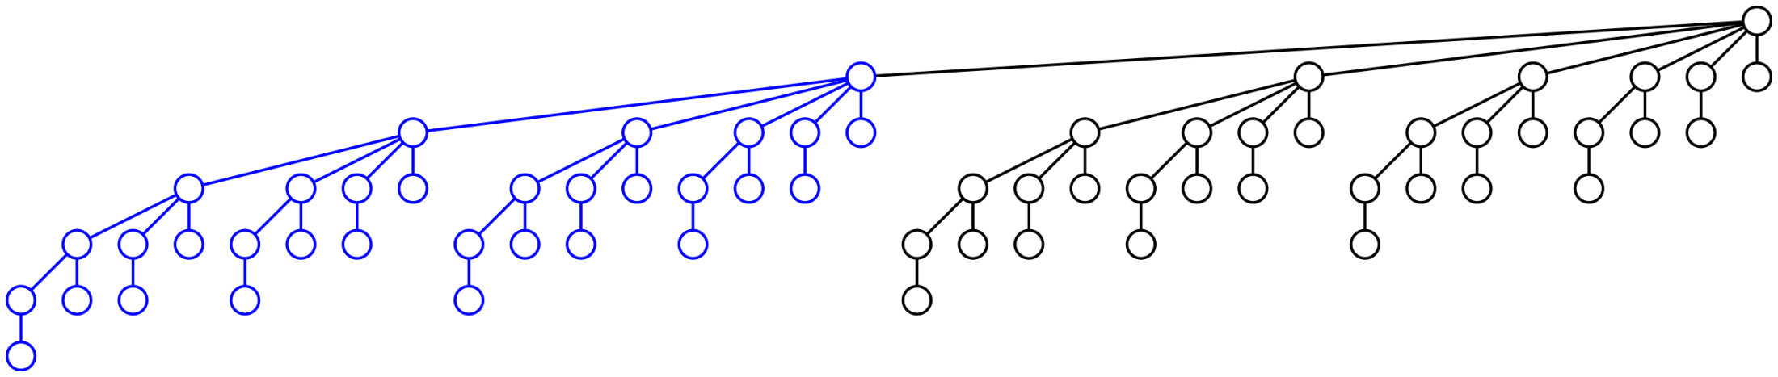
Recursive Definition
As a last example, a binomial tree of order h = 6 is:
A binomial tree of order 5 with an additional sub-tree of order 5

Slide 16
Various Theorems
Theorem
A binomial tree of order h has height h
Proof:
By induction, a binomial tree of order h = 0 has height 0,
Assume it is true that a binomial tree of order h has height h, and
A binomial tree of order h + 1 consists of:
A binomial tree of order h and therefore height h, and
An additional sub-tree of order h and therefore height h
Thus, a binomial tree order h has a height of max(h, h + 1) = h + 1
We will use the terms “order h” and “height h” interchangable

Slide 17
Various Theorems
Theorem
A binomial tree of height h has 2^{h} nodes
Proof:
By induction, a binomial tree of height h = 0 has 1 = 2⁰ nodes,
Assume it is true for a binomial tree of height h, and
A binomial tree of height h + 1 consists of:
A binomial tree of height h with 2^{h} nodes, and
An additional sub-tree of height h with 2^{h} additional nodes
Thus, a binomial tree of height h + 1 has 2^{h} = 2^{h + 1} nodes

Slide 18
Various Theorems
Corollary
A binomial tree with n nodes has a height of lg(n)

Slide 19
Various Theorems
Theorem
A binomial tree of height h has nodes at depth k
Proof:
By induction, a binomial tree of height h = 0 has 1 = 2⁰ nodes,
Assume it is true for a binomial tree of height h, and
A binomial tree of height h + 1 has only one root node and one node at depth h + 1:
The number of nodes at depth k in a tree of height h + 1 has
All the nodes of a binomial tree of height h at depth k, and
All the nodes of a binomial tree of height h at depth k + 1
Thus,

Slide 20
Alternate Definition
An alternate definition of a binomial tree is:
A binomial tree of height h is a root node and has h sub-trees which are binomial trees of heights 0, 1, 2, …, h – 1

Slide 21
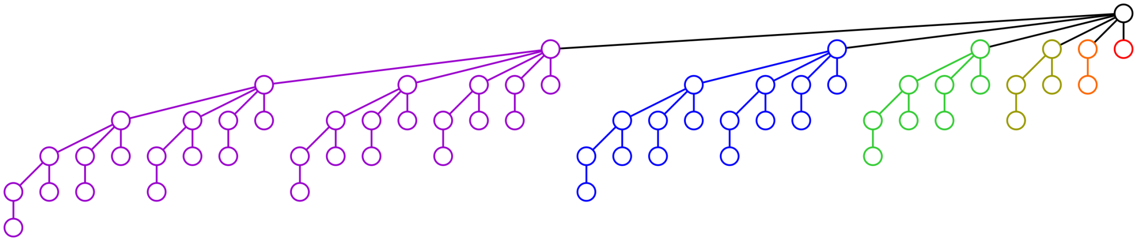
Alternate Definition
For example, this binomial tree of height h = 6 has six sub-trees of heights 5, 4, 3, 2, 1 and 0

Slide 22
Various Theorems
Theorem
The degree of a root of a binomial tree of height h is h
Proof:
This follows trivially from the alternate definition
Corollary
The degree of the root is lg(n)

Slide 23
Various Theorems
Theorem
The root has the maximum degree of any node in a binomial tree
Proof:
Every other node is the root of a binomial tree of height less than h and therefore can only have less than h children

Slide 24
Applications
We will use binomial trees in two applications:
The worst-case scenario for the depth of a disjoint set data structure
Binomial heaps—very fast priority queues

Slide 25
Summary
This topic has covered binomial trees:
A tree of height h with 2^{h} nodes
Same idea as a perfect binary tree
The root has degree h
There are with nodes at depth k

Slide 26
References
[1] Cormen, Leiserson, Rivest and Stein, Introduction to Algorithms, 2nd Ed., MIT Press, 2001, §19.1, pp.457-9.
[2] Weiss, Data Structures and Algorithm Analysis in C++, 3rd Ed., Addison Wesley, §6.8.1, p.240.

Slide 27
Usage Notes
These slides are made publicly available on the web for anyone to use
If you choose to use them, or a part thereof, for a course at another institution, I ask only three things:
that you inform me that you are using the slides,
that you acknowledge my work, and
that you alert me of any mistakes which I made or changes which you make, and allow me the option of incorporating such changes (with an acknowledgment) in my set of slides
Sincerely,
Douglas Wilhelm Harder, MMath
dwharder@alumni.uwaterloo.ca

